Slide 1

& SNUG Social Work Program in the City of Syracuse
RFA Bidder’s Conference
Monday, July 21, 2025 1:00 PM
NYS SNUG Street Outreach
July, 2025
Notes:
Cover Slide

Slide 2
Today’s Agenda
Overview of RFA due dates and mechanics
SNUG Street Outreach Overview
SNUG Social Work Overview
DIVISION OF CRIMINAL JUSTICE SERVICES
2
Notes:
Text / Content Slide

Slide 3
Applications are due by Noon on Tuesday, September 16, 2025
Questions must be written and submitted to: dcjsfunding@dcjs.ny.gov no later than August 1, 2025
Responses to the Questions will be posted on the DCJS website on or about August 15, 2025 https://www.criminaljustice.ny.gov/ofpa/index.htm
Award Notifications will be made on or about October 8, 2025
Anticipated Contract start date is January 1, 2026
SNUG Street Outreach RFA
DIVISION OF CRIMINAL JUSTICE SERVICES
3
Notes:
Text / Content Slide

Slide 4
SNUG Overview
SNUG utilizes a public health approach to address gun violence by identifying the source, interrupting the transmission, and changing group norms.
Comprehensive state oversight allows for the program to be delivered consistently across the 14 communities served by the program, even though a local nonprofit organization administers the state and federal grant funding in those communities.
New York’s SNUG Street Outreach program is unique from others that operate in the state and communities across the country because of its strong state oversight, administration, technical assistance, and training.
The state-specific model has comprehensive policies and protocols related to hiring, identifying high-risk participants, interacting with police, and the use of data to identify neighborhoods served by the program.
The program also embeds social workers and case managers at SNUG sites and hospitals to assist individuals and families who don’t often identify as victims, have trauma resulting from long-term exposure to violence, and may be skeptical or hesitant to seek counseling and case management support.
DIVISION OF CRIMINAL JUSTICE SERVICES
4
Notes:
Text / Content Slide

Slide 5
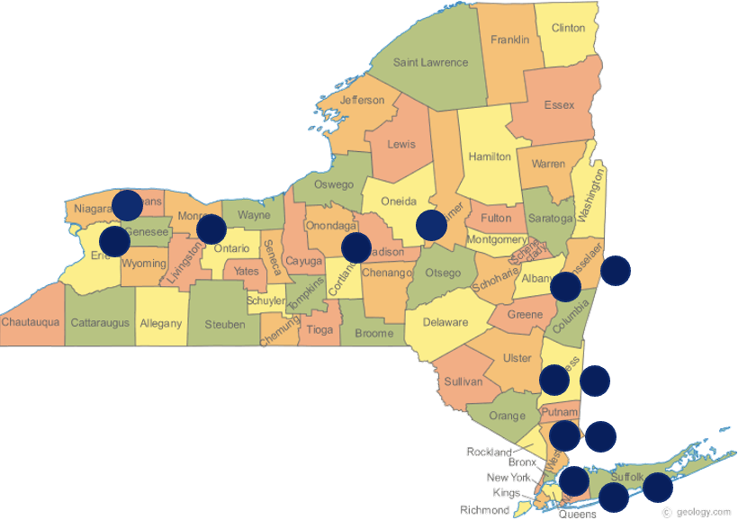
Target Areas: A designated section of a city where rates of violence are high and where SNUG outreach teams focus their efforts
SNUG Sites in New York State
Target Areas: A designated section of a city where rates of violence are high and where SNUG outreach teams focus their efforts
Locations:
Buffalo
Rochester
Syracuse
Albany
Troy
Poughkeepsie
Newburgh
Mount Vernon
Yonkers
Bronx
Hempstead
Wyandanch
Niagara
Utica
DIVISION OF CRIMINAL JUSTICE SERVICES
5
Notes:
Text / Content Slide

Slide 6
SNUG Outreach Staff Training
All new SNUG employees receive 40 hours of training, and all supervisors receive training through a 32- hour intensive management program.
Training for SNUG outreach teams in Trauma Systems Therapy began in 2020 and continues to add a trauma-informed lens to all aspects of SNUG outreach.
Outreach teams and Social Work staff have had an intensive Motivational Interviewing curriculum that began in early 2022 and is ongoing.
DCJS is committed to ongoing, innovative trainings for all SNUG workers to help them grow professionally. SNUG has recently received training in topics such as hip-hop therapy, black male grief, vicarious trauma, Healing Centered Engagement, and human trafficking.
DIVISION OF CRIMINAL JUSTICE SERVICES
6
Notes:
Text / Content Slide

Slide 7
SNUG Participants
By engaging with the highest risk youth, SNUG provides young people who are disconnected from their families, schools and communities with positive role models, healthy relationships and hope for a future without violence.
Outreach workers take participants to events and places they have never had the opportunity to see. They connect them with resources such as educational institutions and job training services – to help break patterns of violence. They also connect participants, as well as their friends and families, to SNUG case management and mental health services.
SNUG participants are required to meet at least 4 of the criteria below:
14-25 years of age
Active in a street organization
History of violence
Engaged in high-risk activity
Weapons carrier *if someone is a weapons carrier, they are not required to meet any other criteria*
Recently shot, or have a family member who has been shot within last 6 months
Recently released from prison
DIVISION OF CRIMINAL JUSTICE SERVICES
7
Notes:
Text / Content Slide

Slide 8
Conflict Mediations
Outreach workers leverage their ties within the community and respond to shootings to prevent retaliation, detect conflicts and resolve them peacefully before they lead to additional violence.
SNUG personnel are notified by members of the community or law enforcement contacts when shootings involving injuries occur so that they can respond to address any retaliatory plans that might be formulating.
Anytime a shooting involving injury occurs in a SNUG target area, SNUG Outreach and Social Work teams respond to the shooting scene and the hospital to begin work on ending the cycle of gun violence.
SNUG’s presence at the hospital ER has been instrumental in stopping further violence and settling things down.
DIVISION OF CRIMINAL JUSTICE SERVICES
8
Notes:
Text / Content Slide

Slide 9
Community Engagement & Shooting Responses
The goal of SNUG outreach is to change behaviors, attitudes and social norms related to gun violence by using credible messengers to deliver those key messages to both the highest-risk and the community at large.
SNUG Outreach teams engage residents, religious leaders and law enforcement to change social norms and behaviors that perpetuate violence.
Street outreach workers work with neighborhood organizations and other community groups to organize events and public education activities that stand against gun violence.
DIVISION OF CRIMINAL JUSTICE SERVICES
9
Notes:
Text / Content Slide

Slide 10
SNUG/Police Relationship
In each city, the SNUG Program Manager, Police Liaison, and Crime Analyst meet at least once per month to discuss:
Shootings within or related to the SNUG target area
Information received by police about potential high-risk participants (one-direction information sharing; SNUG does not provide information to police)
Discuss potential gang problems that may arise in public areas like schools, train stations, malls, etc. which allows SNUG to have a presence in those areas and prevent incidents from occurring
Importance of SNUG’s credibility in the community:
SNUG members should not be seen as working with police
The credibility of the outreach team is imperative to working closely with the highest-risk individuals
Only the program manager interacts with police
Police interaction with SNUG staff should look like an interaction with any citizen of that city (no special treatment)
DIVISION OF CRIMINAL JUSTICE SERVICES
10
Notes:
Text / Content Slide

Slide 11
How Is SNUG Different From Other Outreach Programs?
Only statewide gun violence prevention outreach program in the country
Unique relationship with police department: the police are responsible for notifying the program manager about any shooting in the target area within 2 hours of the incident, monthly check-ins
Training Program developed in-house and provided by SNUG administrators and site-based staff around the state who have become specialized trainers
Set up our own computer database for documentation with de-identified data
Developed oversight by DCJS SNUG Administrators for risk management and risk assessment
Monthly unannounced on-site visits by SNUG Training Director with each site, to determine fidelity to the training and model
Monthly check-in calls with outreach supervisors and program managers to discuss shooting numbers and trends
Social workers embedded at each site to support the SNUG team, program participants, and community members
Oversite is key to the consistency of the program
DIVISION OF CRIMINAL JUSTICE SERVICES
11
Notes:
Text / Content Slide

Slide 12
SNUG Social Work/Case Management
Notes:
Section Slide

Slide 13

SNUG Social Work/Case Management
SNUG SWs and CMs are embedded in SNUG sites to enhance services provided
Outreach Team
Social Worker
At the heart of SNUG
Focused on mediating conflicts and preventing violence/retaliation
Able to engage and build relationships with high-risk participants
Personal experience that enhances ability to connect to participants
Complements and supports SNUG
Ability to navigate social services for clients
Trauma-informed treatment and practices
Resources, tools, and education to support work of outreach team
DIVISION OF CRIMINAL JUSTICE SERVICES
13
Notes:
Text / Content Slide

Slide 14
SNUG Social Work/Case Management Component
Social Workers
Provide mental health support and safety-planning/emergency services to those affected by violence
Case Managers
Help meet the concrete needs of those in the community affected by violence
DIVISION OF CRIMINAL JUSTICE SERVICES
14
Notes:
Text / Content Slide

Slide 15
Goals of SNUG Social Work/Case Management
Support SNUG program participants who are at the highest risk of being shot or shooting someone; outreach workers use the trust they’ve built with their high-risk participants to facilitate relationships with the social worker
  Utilize outreach worker credibility to overcome social work stigma
  Social work presence in the community
  Case conferencing
Work with individuals affected by community violence, including friends and family who have been impacted
  Therapy
  Concrete services (i.e. case management)
  Financial compensation
  Safety relocation
DIVISION OF CRIMINAL JUSTICE SERVICES
15
Notes:
Text / Content Slide

Slide 16
Goals of SNUG Social Work/Case Management
3. Provide support, training and guidance to SNUG team members
  Help team process difficult situations and heal from trauma
  Provide trainings such as Trauma Systems Therapy (TST), motivational interviewing, and alternative therapies (music equipment and programming)
  Starting program to provide therapy to SNUG staff
4. Build a direct connection between SNUG sites and hospitals
DIVISION OF CRIMINAL JUSTICE SERVICES
16
Notes:
Text / Content Slide

Slide 17
SNUG/Hospital Connection
SNUG is located in 5 trauma centers around the state and has MOUs with smaller hospitals as well
  Fund hospital-based social workers, psychiatrists, pediatricians, trauma surgeons
Breaking barriers between the hospital and community-based services
Get a read on the family and friends and address issues around retaliation
“Golden hour” of engagement immediately after an incident
SNUG hospital-based social worker assists family with safety planning
SNUG team begins relationship in the hospital and follows post-discharge
DIVISION OF CRIMINAL JUSTICE SERVICES
17
Notes:
Text / Content Slide

Slide 18
Thank you!
Notes:
Section Slide

